Slide 1

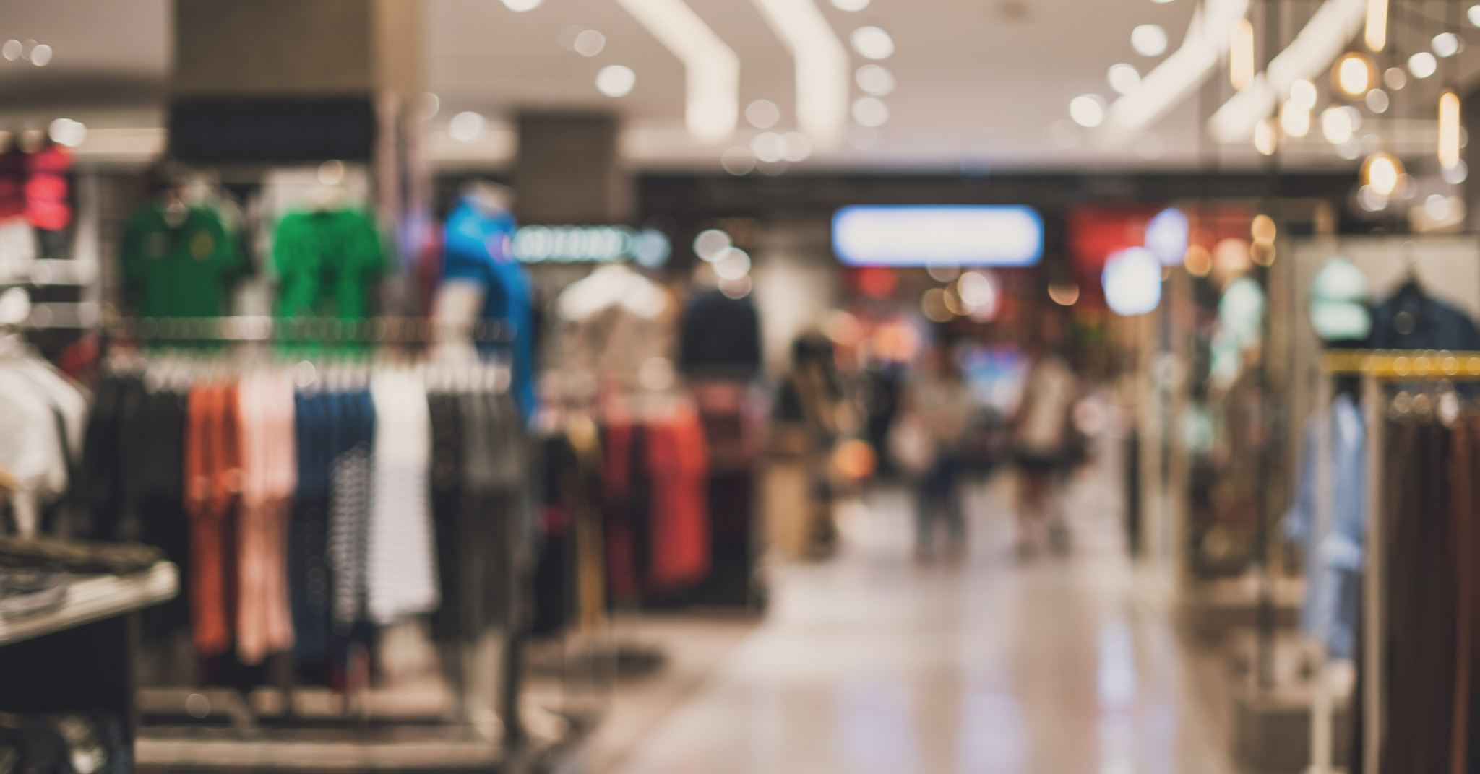

Customer Dataset
Denzel See DAAA2A07 2222840

Slide 2
Objective
To build a model to separate the data into clusters and find the most valuable group of customers to the mall.

Slide 3
Data visualization + cleaning

Slide 4
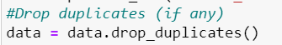
Removing any duplicates
I dropped any duplicates in the dataset if there is any

Slide 5
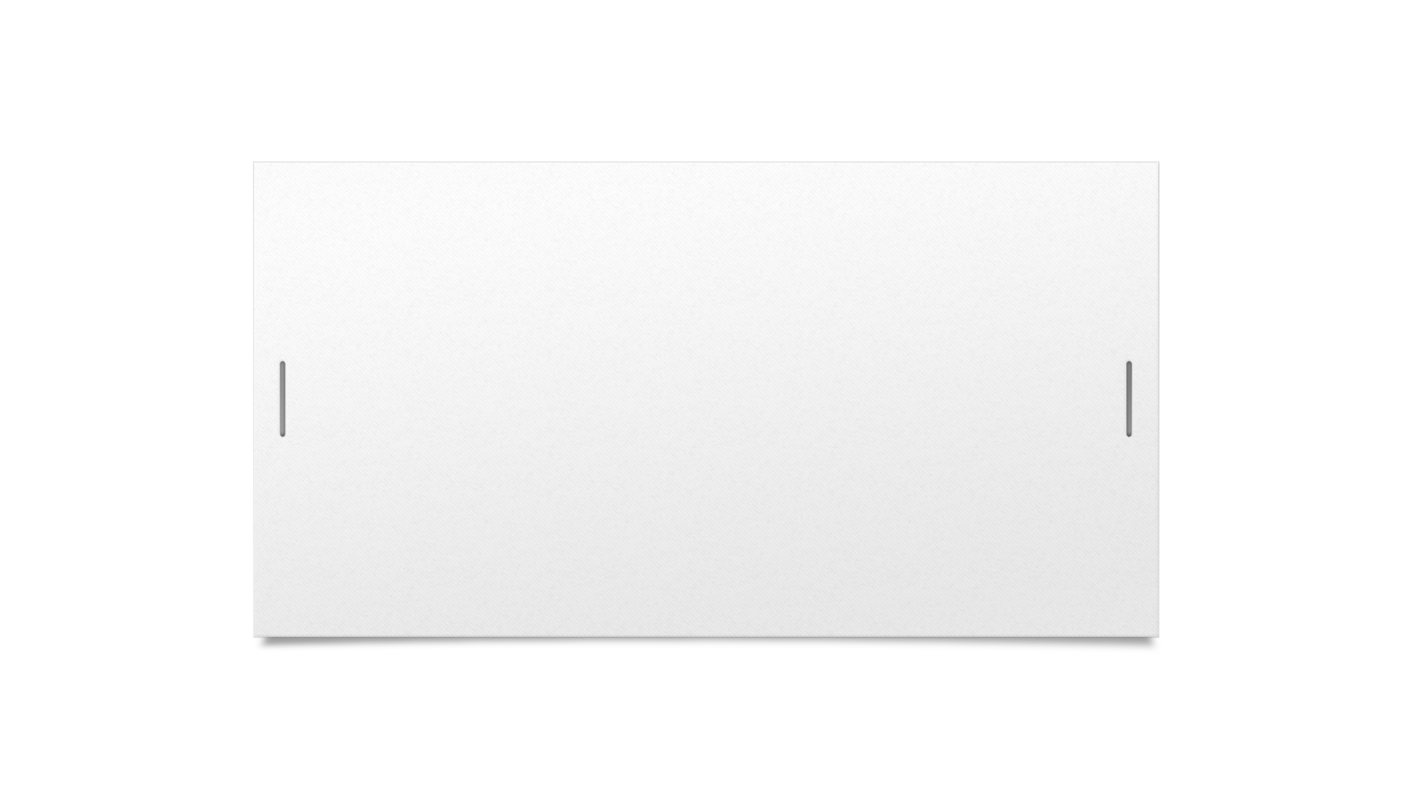

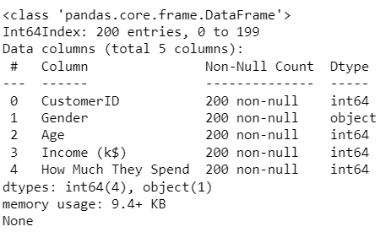

Printing Data Information
I used .info to print out the dataset’s information

Slide 6
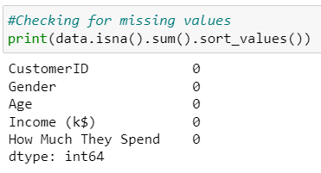
Checking for Nulls
I used this code to check the dataset for any nulls values.

Slide 7
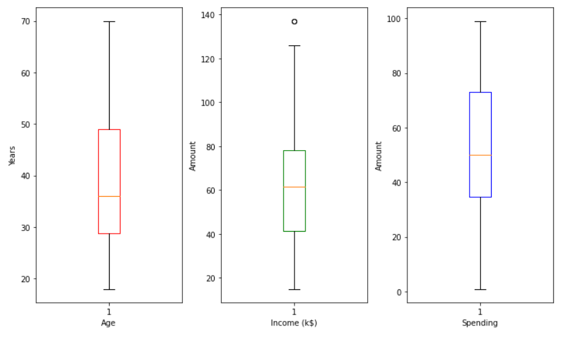
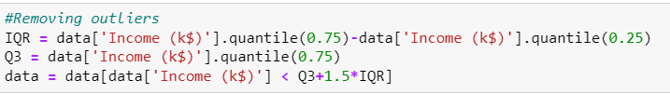
Checking for outliers
I plotted boxplots to check for outliers.
I then removed the outliers by deciding a range of Q3+1.5*IQR and removing any data about that threshold

Slide 8

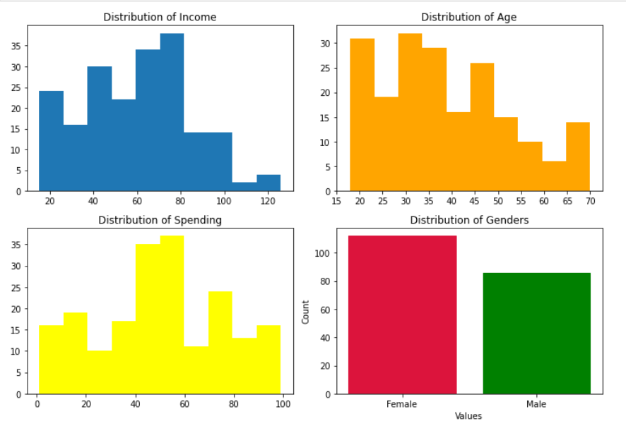
Histograms
I also plotted histograms and count plot, just to get a better understanding of the distribution of the data.

Slide 9
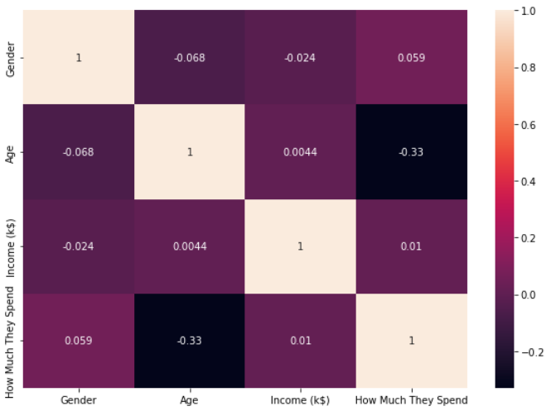
Correlation heatmap
This is a correlation heatmap that I used to see the correlation between features.
I did not remove any features since there was not any highly correlated features in the dataset

Slide 10

Feature selection

Slide 11

Gender
I found the general trend is that men spend more expenditure per trip then woman do and have vastly different shopping style. The type of product men tend to buy are also different which could have some effect on the higher expenditure. Thus, I decided to keep Gender.

Slide 12

Age
From two different articles, the general trend of age have different expenditure , partly due to maturity and disposable income, which is enough to show that Age will have an impact in sorting out clusters. Thus, I decided to keep the Age column.

Slide 13

Income
The income effect, in microeconomics, is the resultant change in demand for a good or service caused by an increase or decrease in a consumer's purchasing power or real income. As one's income grows, the income effect predicts that people will begin to demand more. Thus, I decided to keep the Income column since the income of individuals will affect the expenditure which in turn can decide which cluster is good for the mall.

Slide 14

How Much They Spend
It is a score range from 0 - 100, the higher the score, the more the customers spend which is a very good gauge for finding out which clusters is valuable to the mall. Thus, I decided to keep How Much They Spend.

Slide 15
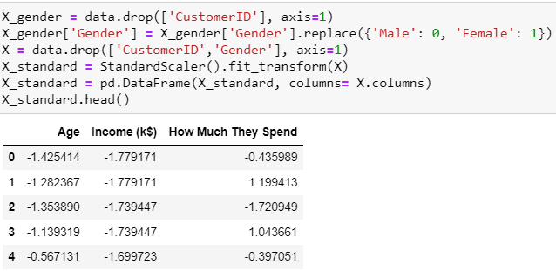
Dimensional Reduction(PCA)
Since I am using PCA, I standardized my data using StandardScaler
I also removed gender since it is a categorical variable and will add it back later

Slide 16
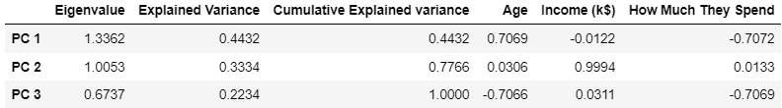
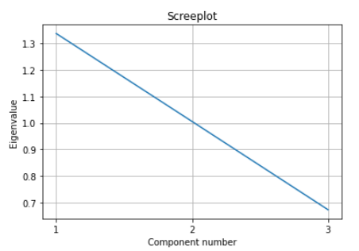
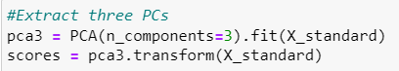
Determine PCs to keep
There is no elbow in scree plot and percentage of total variance is too little if I kept 2 PCs thus, I decided to keep all 3 PCs.

Slide 17
Models
I used KMeans since it is well-suited for evenly sized, well-separated clusters
I used Ward Hierarchical Clustering as it is suitable for datasets where the focus is on understanding the hierarchical organization of customer segments.
I used Gaussian Mixture in case of overlapping patterns and because the data had non-linearly separable data

Slide 18
Models
By using KMeans, Ward hierarchical clustering, and Gaussian Mixture, I can explore different clustering perspectives and gain insights into the data from multiple angles as each algorithm's strengths and capabilities complement one another

Slide 19
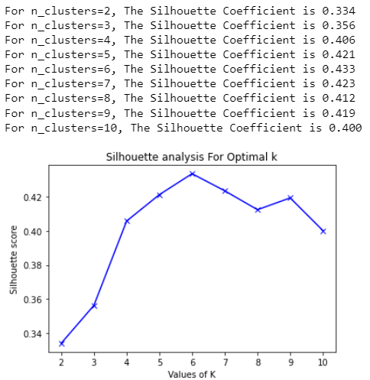
Finding Optimal Number of Clusters
I used a for loop to find the optimal number of clusters for each model by using silhouette score as a metric.

Slide 20
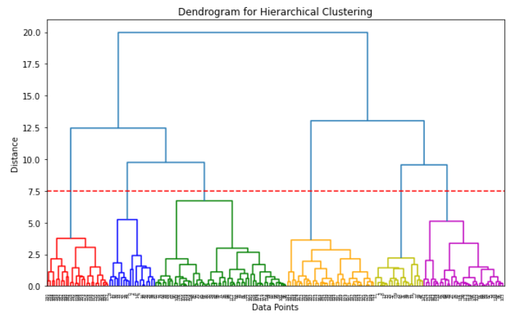
Finding Optimal Number of Clusters
For Ward hierarchical clustering, I also used a dendrogram to visualize the clusters that the data could be split into and decided a good distance threshold where clusters have enough detail.
It also corresponds with the silhouette score plot

Slide 21
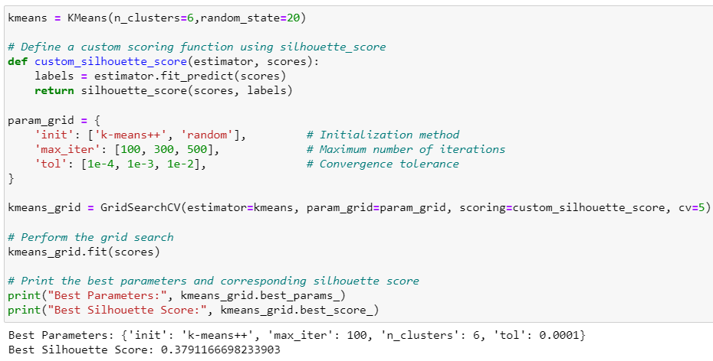
Optimizing Hyperparameters
I used GridSearchCV to find the best hyperparameters for each model, again using silhouette score as a metric

Slide 22
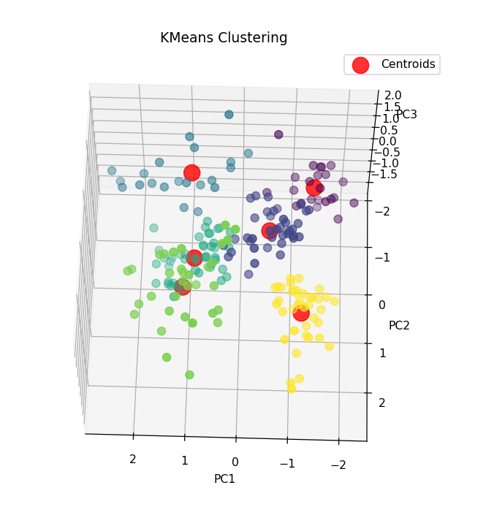
KMeans Clustering Model

Slide 23
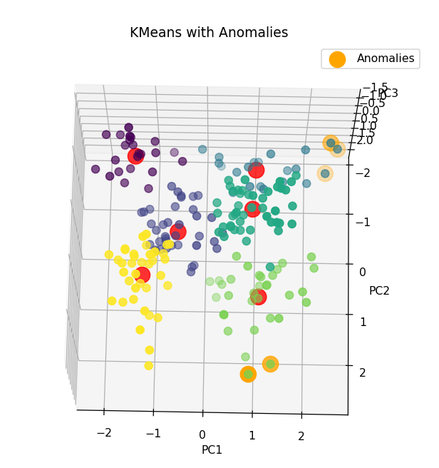
Anomaly Detection
I found the anomalies and plotted them in orange

Slide 24
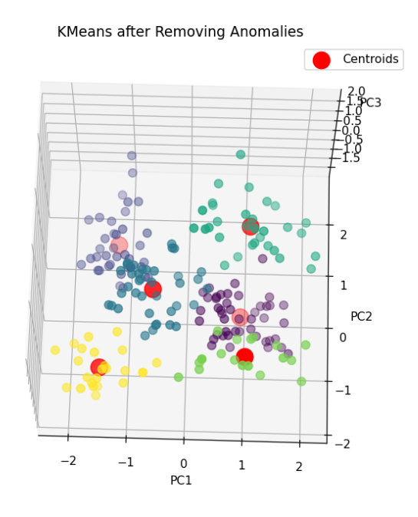
After Removing Anomalies

Slide 25
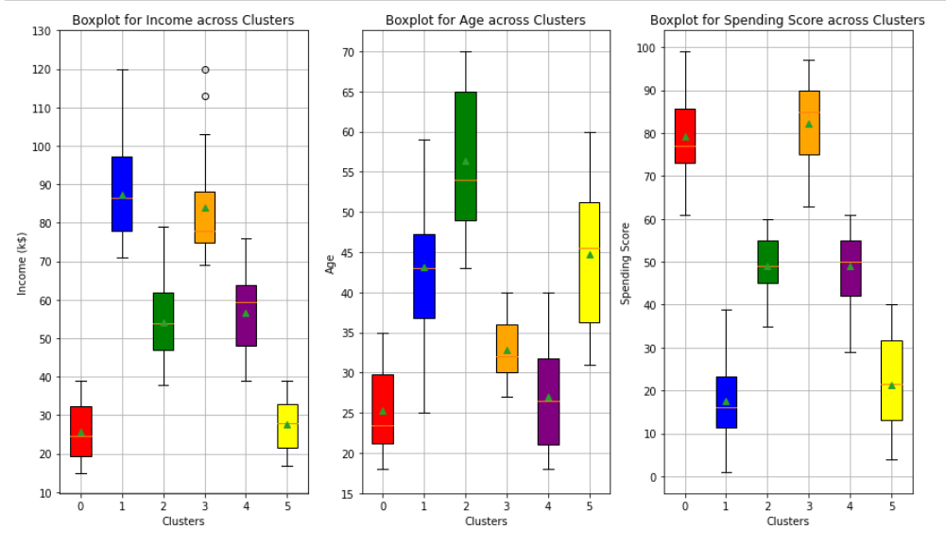
Evaluation
I grouped the data by clusters and plotted out the different features

Slide 26
Evaluation
One customer groups emerge as the most prominent. Generally, the most valuable group appears to have an age around the 30s and have a high-income level. Their considerable income of 84.3k suggests strong purchasing power and they tend to prefer luxury or upscale shopping, making them a highly important target group for the mall's premium products and services.

Slide 27
Conclusion
Gender is not important since every cluster have no distinct groups of gender.
The most valuable group appears to be the customers in their 30s with a high-income.
Malls can add more things to cater to these customers, such as extending special business hours to accommodate their schedules. (Assuming they are businessmen or women)

